Slide 1



Telecom Company
CUSTOMER
SEGEMENTATION
Presented by: kieudieungan

Slide 2

OVERVIEW
01
02
03
Objectif
Data
Tools
04
05
06
Model
Conclusion
Strategy

Slide 3





OBJECTIF
COMPANY BUSINESS
ANALYSIS OBJECTIF
Company provides telecommunication services to households within the city area. The services offered encompass telephone networks, internet, fiber-optic cable television, equipment maintenance services, and more..
Company is looking to enhance the service experience and provide services that accurately meet the needs of customers to retain their loyalty.

Slide 4
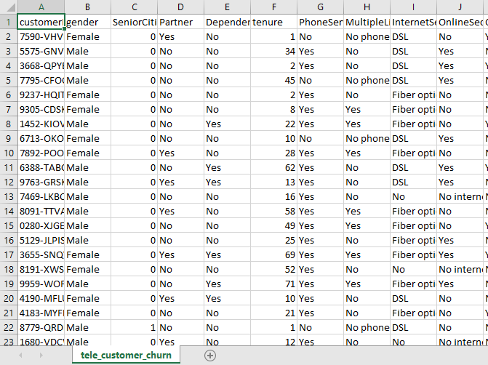
DATA
Dataset: tele_customer_churn.csv
Customer infomation (ID, gender, senior citizen, partner, dependent)
Services used by customer (phone, internet, streaming, online security, online backup, tech support)
Contract and Revenue (contract type, monthly charges, total charges)
Payment (payment method, paperless billing)

Slide 5



TOOLS
Google Colab
Python

Slide 6
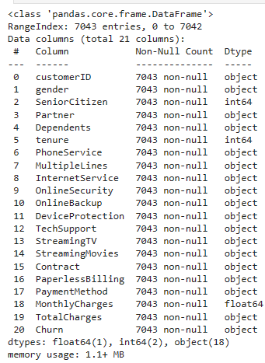
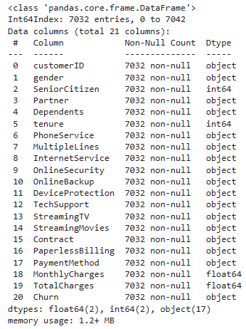
MODEL
Data processing
Convert data type in TotalCharges column to float.
Check and drop NaN values (11 values)
Check duplicated rowa

Slide 7
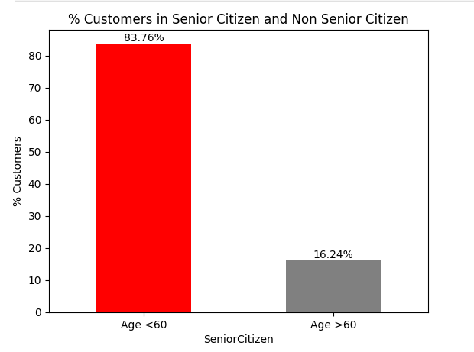
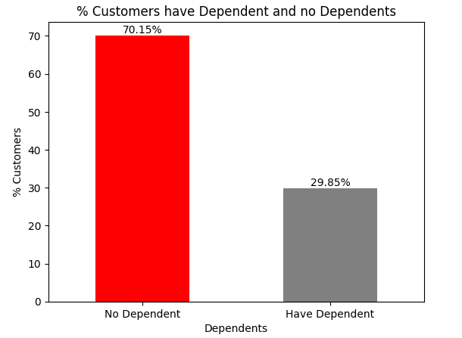
MODEL
Data Overview
83% of customers belong to the young and middle-aged group (under 60 years old).
70% of customers are either single or married without children.

Slide 8
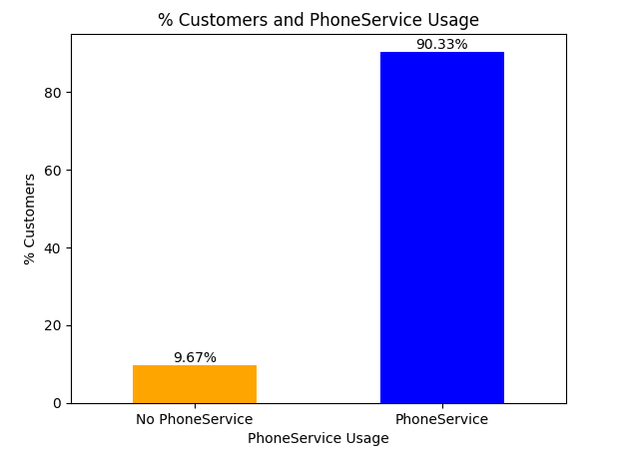
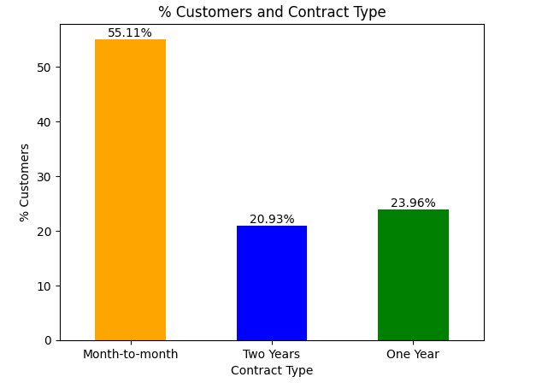
MODEL
Data Overview
9.6% of customers are not subscribed to mobile services, and 21.7% are not subscribed to internet services.
55% of customers subscribe to monthly plans, while the rest opt for 1-year and 2-year plans.

Slide 9
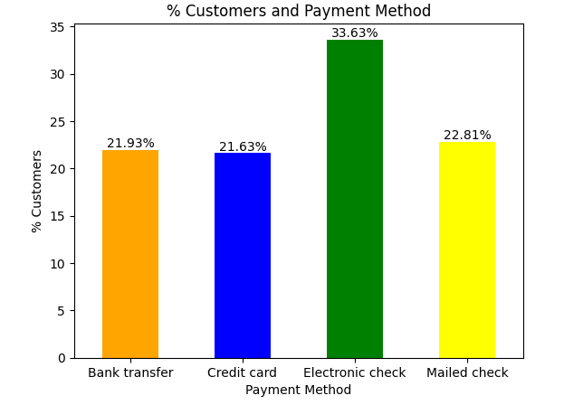
MODEL
Data Overview
33% of customers make electronic bill payments, while the remaining prefer payment methods such as bank transfers, mail, and credit cards.

Slide 10
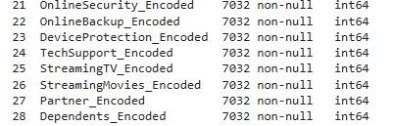
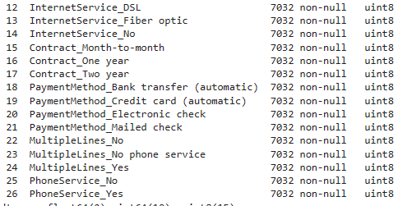
MODEL
Encoding
Encoding categorical variables from text format to numerical format using Label Encoder.
Encoding variables with unordered values into numerical format using get_dummies

Slide 11
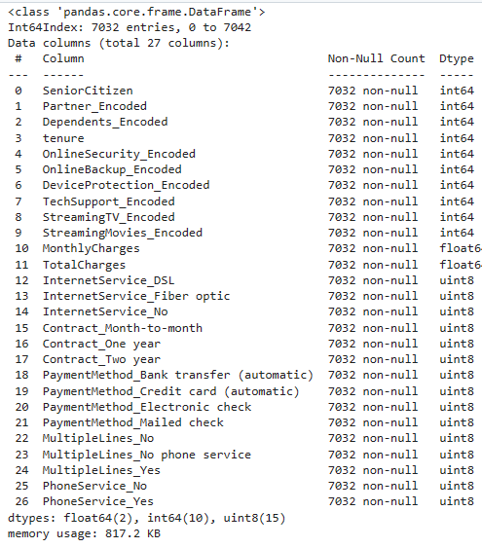
MODEL
Encoding

Slide 12
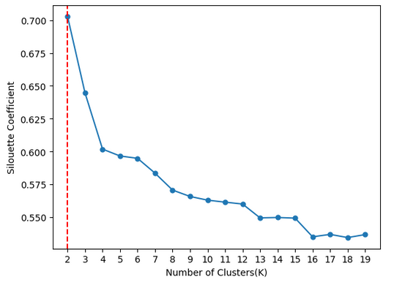
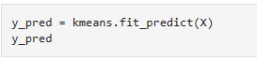
MODEL
Modeling
Choose X variables from customer_segmentation_encoded.
Find K
Build Kmeans model with n_clusters =2
Predict y

Slide 13
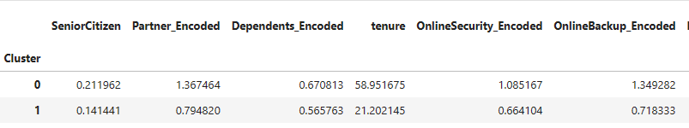
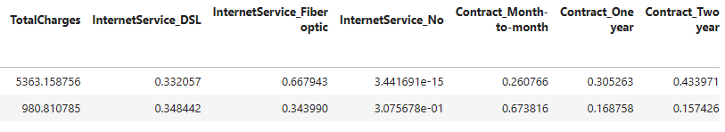
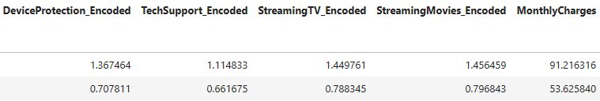
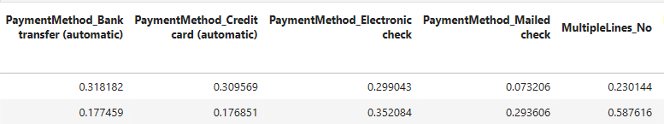
CONCLUSION

Slide 14
CONCLUSION
Group 0: Customers with High Expenditure on Telecommunication Services
Use phone services with multiple lines and subscribe to additional internet-related services such as movies, TV, technical support, equipment maintenance, and cybersecurity services.
Prefer to use automatic payments (bank transfers/credit cards).
Opt for annual service subscriptions and have been using the services for a long period.
Older individuals, already married, and have financial dependents.
Group 1: Customers with Low Expenditure on Telecommunication Services
Not use phone services or, if they do, they do not have multiple lines and not having tendency to subscribe to additional internet-related services
Prefer to make payments by mail or through invoices.
Opt for monthly service plans and have a shorter duration of service usage.
Typically young or middle-aged individuals who are not married and do not have financial dependents.

Slide 15
STRATEGY
Continue to maintain the current services satisfactorily for this customer group.
Group 0: Customers with High Expenditure on Telecommunication Services
Offer distinct service packages for each sub-segment (singles, married couples without children, and families with children.
Provide incentives for payment through bank transfers or credit cards to expedite the payment process.
Group 1: Customers with Low Expenditure on Telecommunication Services

Slide 16




Telecom Company
Thank's For Watching
Connect with us.
+123-456-7890
telecomcompany@

